Slide 1
State Transition Testing
State transition testing is used where some aspect of the system can be described in what is called a 'finite state machine'.
This simply means that the system can be in a (finite) number of different states, and the transitions from one state to another are determined by the rules of the 'machine'.
This is the model on which the system and the tests are based.
Any system where you get a different output for the same input, depending on what has happened before, is a finite state system.
A finite state system is often shown as a state diagram

Slide 2
State Transition Testing …
A state transition model has four basic parts:
the states that the software may occupy (open/closed or funded/insufficient
funds);
the transitions from one state to another (not all transitions are allowed);
the events that cause a transition (closing a file or withdrawing money);
the actions that result from a transition (an error message or being given
your cash).
Note that in any given state, one event can cause only one action, but that the same event - from a different state - may cause a different action and a different end state.

Slide 3
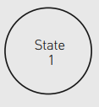

State Transition Diagrams
A state transition diagram is a representation of the behaviour of a system.
It is made up from just two symbols.
The first is which is the symbol for a state.
A state is just what it says it is: the system is ‘static’, in a stable condition from which it will only change if it is stimulated by an event of some kind.
For example, a TV stays ‘on’ unless you turn it ‘off’; a multifunction watch tells the time unless you change mode.
The second is which is the symbol for a transition, i.e. a change from one state to another.
The state change will be triggered by an event (e.g. pressing a button or switching a switch).
The transition will be labelled with the event that caused it and any action that arises from it.
So we might have ‘mode button pressed’ as an event and ‘presentation changes’ as the action.
Usually (but not necessarily) the start state will have a double arrow head pointing to it. Often the start state is obvious anyway.

Slide 4
… State Transition Diagrams
If we have a state transition diagram representation of a system we can analyse the behaviour in terms of what happens when a transition occurs.
Transitions are caused by events and they may generate outputs and/or changes of state.
An event is anything that acts as a trigger for a change; it could be an input to the system, or it could be something inside the system that changes for some reason, such as a database field being updated.
In some cases an event generates an output,
in others the event changes the system’s internal state without generating an output,
and in still others an event may cause an output and a change of state.
What happens for each change is always deducible from the state transition diagram.

Slide 5
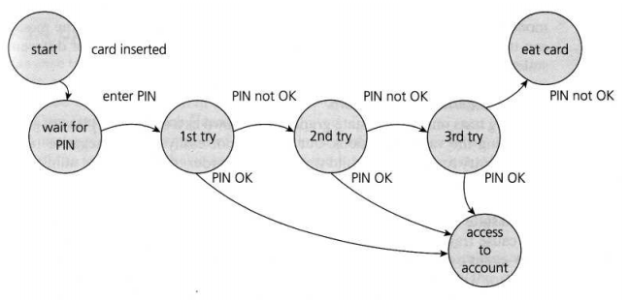
… State Transition Diagrams – Example

Slide 6
… State Transition Diagrams – Deriving Test Cases
this state diagram, even though it is incomplete, still gives us information on which to design some useful tests and to explain the state transition technique.
In deriving test cases, we may start with a typical scenario.
A sensible first test case here would be the normal situation, where the correct PIN is entered the first time.
To be more thorough, we may want to make sure that we cover every state (i.e. at least one test goes through each state) or we may want to cover every transition.
A second test (to visit every state) would be to enter an incorrect PIN each time, so that the system eats the card.
We still haven't tested every transition yet. In order to do that, we would want a test where the PIN was incorrect the first time but OK the second time, and another test where the PIN was correct on the third try. These tests are probably less important than the first two.
Test conditions can be derived from the state graph in various ways.
Each state can be noted as a test condition, as can each transition.

Slide 7
State Table (ST) - Deriving Negative Test cases
Deriving tests only from a state graph (also known as a state chart) is very good for seeing the valid transitions, but we may not easily see the negative tests, where we try to generate invalid transitions. In order to see the total number of combinations of states and transitions, both valid and invalid, a state table is useful.
The state table lists all the states down one side of the table and all the events that cause transitions along the top (or vice versa).
Each cell then represents a state-event pair. The content of each cell indicates which state the system will move to, when the corresponding event occurs while in the associated state.
This will include possible erroneous events - events that are not expected to happen in certain states.
These are negative test conditions.

Slide 8
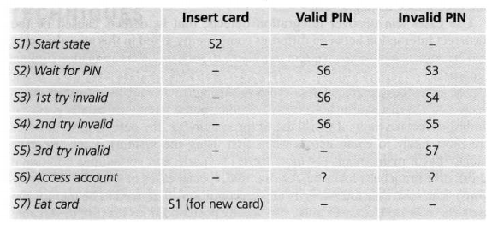
State Table (ST) - Example

Slide 9
State Table (ST) – Example
Example lists the states in the first column and the possible inputs across the top row.
So, for example, if the system is in State 1, inserting a card will take it to State 2.
If we are in State 2, and a valid PIN is entered, we go to State 6 to access the account.
In State 2 if we enter an invalid PIN, we go to State 3.
We have put a dash in the cells that should be impossible, i.e. they represent invalid transitions from that state.
We have put a question mark for two cells, where we enter either a valid or invalid PIN when we are accessing the account.
Perhaps the system will take our PIN number as the amount of cash to withdraw? It might be a good test!
Most of the other invalid cells would be physically impossible in this example.
Invalid (negative) tests will attempt to generate invalid transitions, transitions that shouldn't be possible (but often make good tests when it turns out they are possible).

